Slide 1
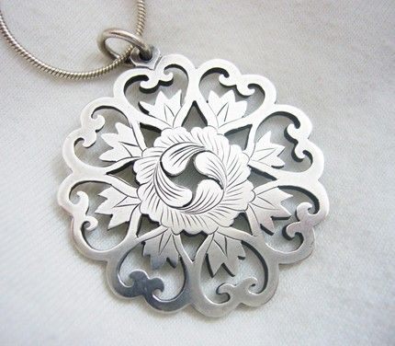
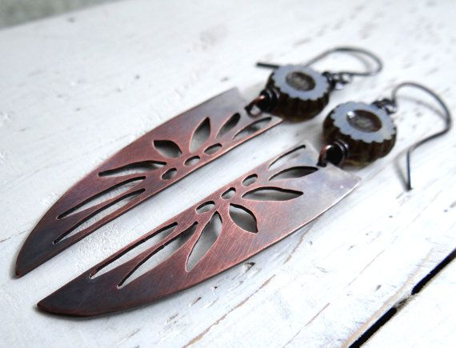
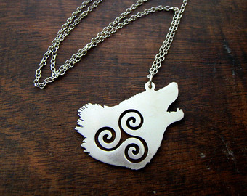
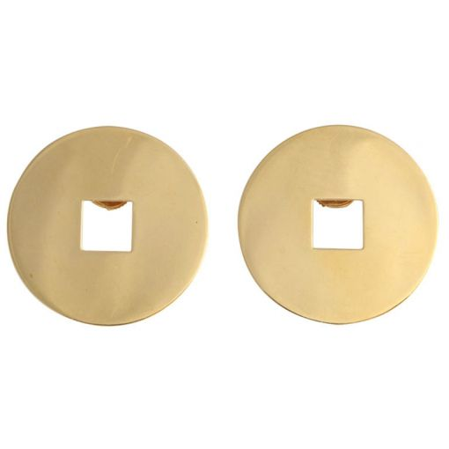
SHAPE IN A SHAPE

Slide 2
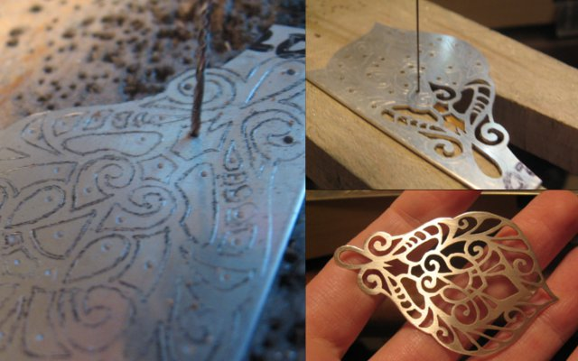
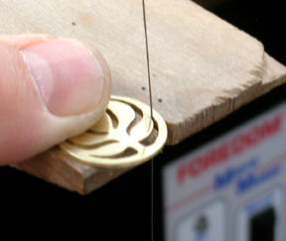
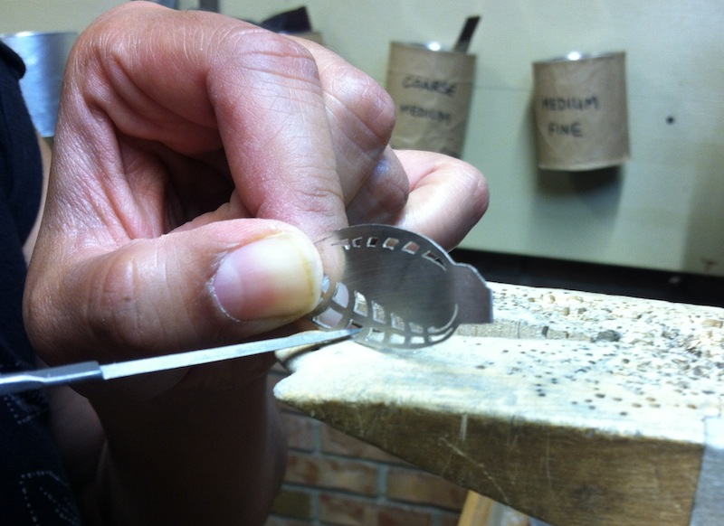
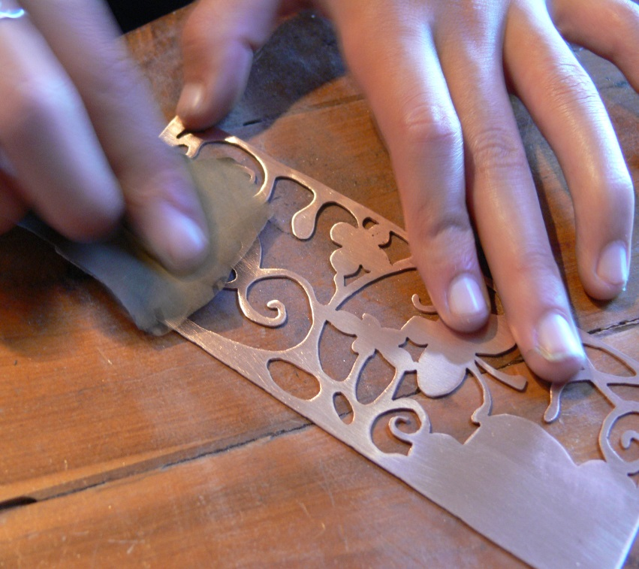
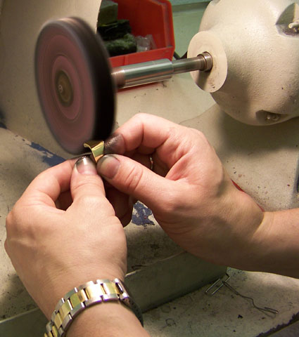
Five Basic Jewelry Processes
2. Sawing
1. Piercing-drilling a hole
5. Polishing
3. Filing
4. Sanding

Slide 3
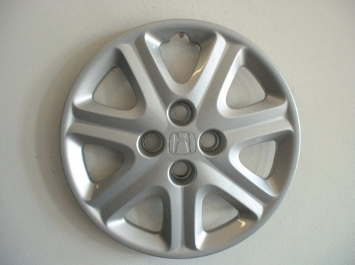
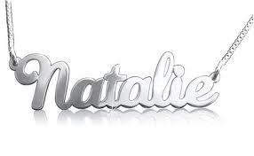
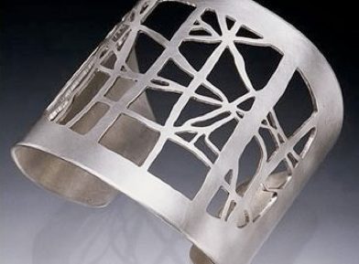
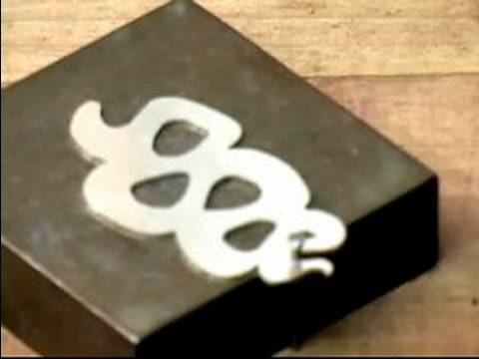
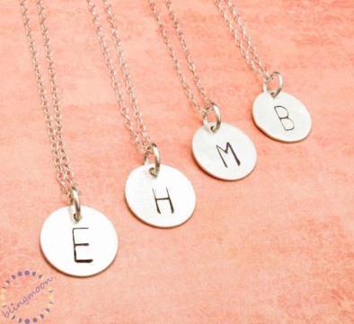
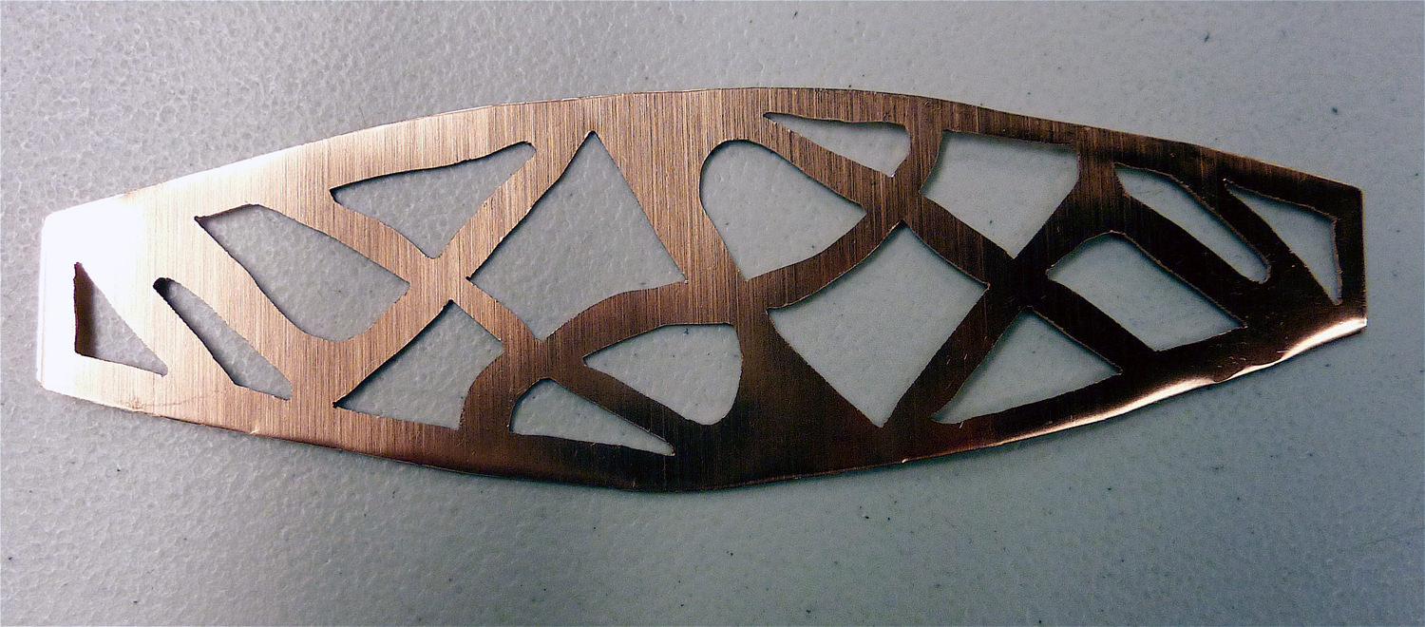
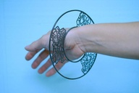
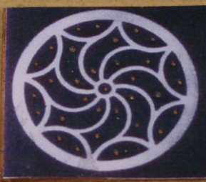
HUB CAPS, INITIALS, CULTURE, CONTRAST SHAPE

Slide 4
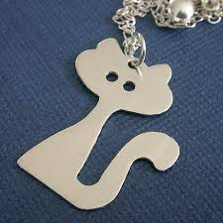
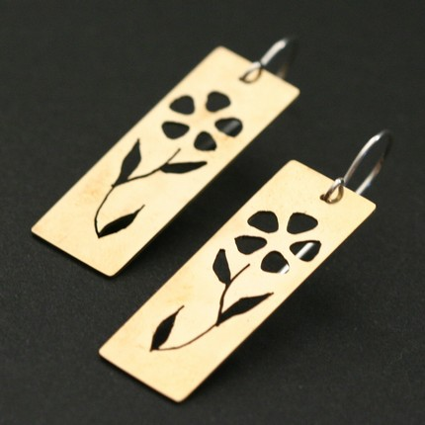
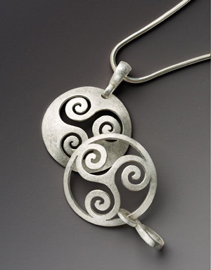
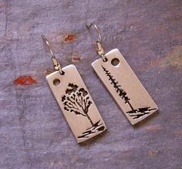
CONT…

Slide 5
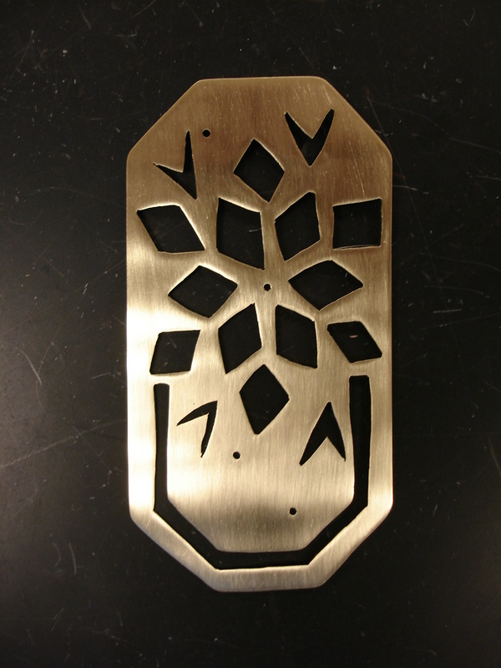
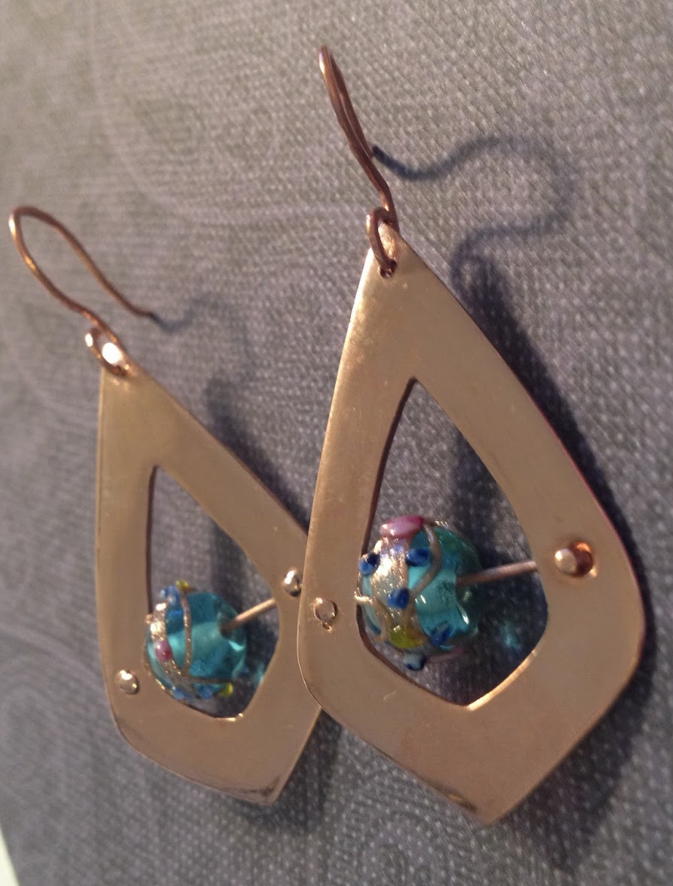
MORE STILL…

Slide 6
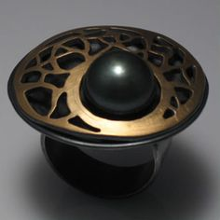
KRISTY KLUG

Slide 7
BASIC JEWELRY PROCESSES
https://www.youtube.com/watch?v=yRYfXwBIMhY how to saw 4:49
https://www.youtube.com/watch?v=8_hgq8Xls78 how to piece the metal 2:19
https://www.youtube.com/watch?v=1Za_kKB7EIk how to file 2:34
https://www.youtube.com/watch?v=OyBPt_TqYbs how to sand your project 5:50
https://www.youtube.com/watch?v=mVz5dr7WyUs how to polish (no sound) 2:09

Slide 8
REQUIREMENTS
Design must fit process.
Design must be original.
Proficient Craftsmanship.
Follow all five basic jewelry processes.

