Slide 1
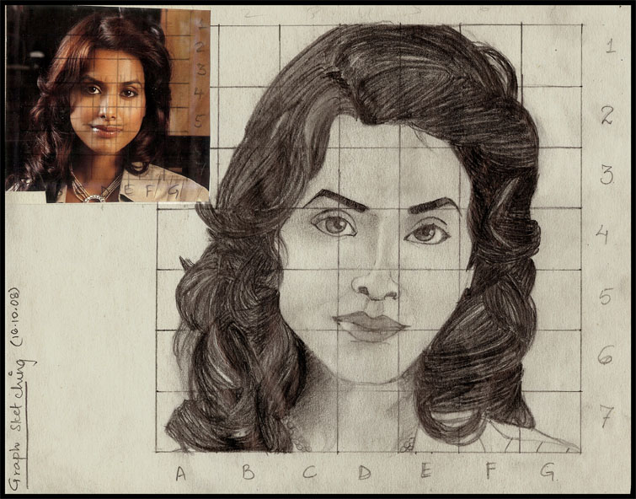
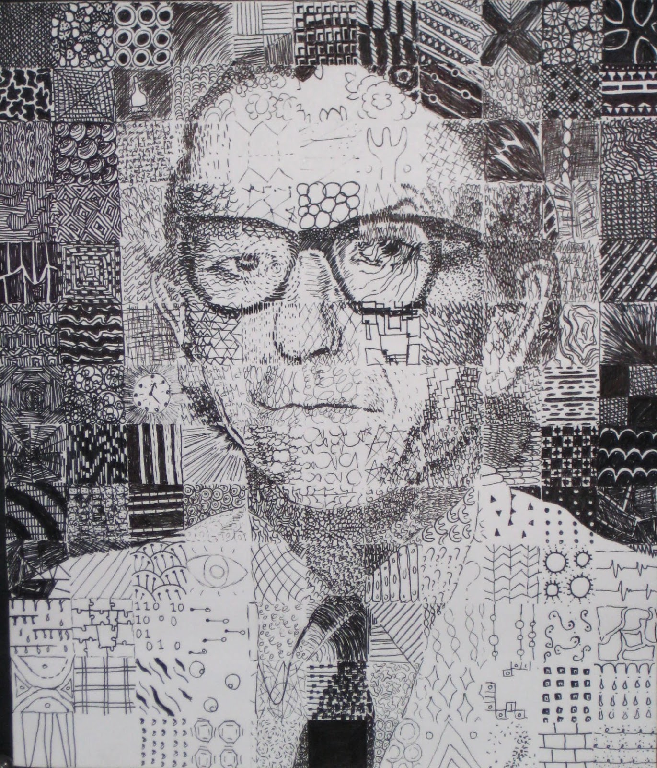
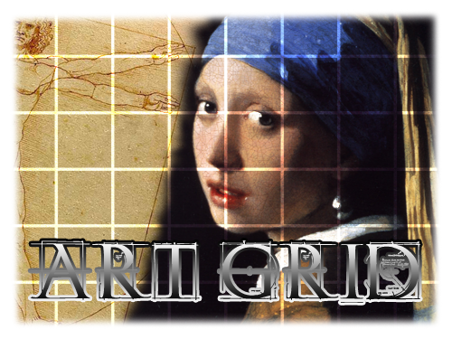
GRID DRAWINGS

Slide 2
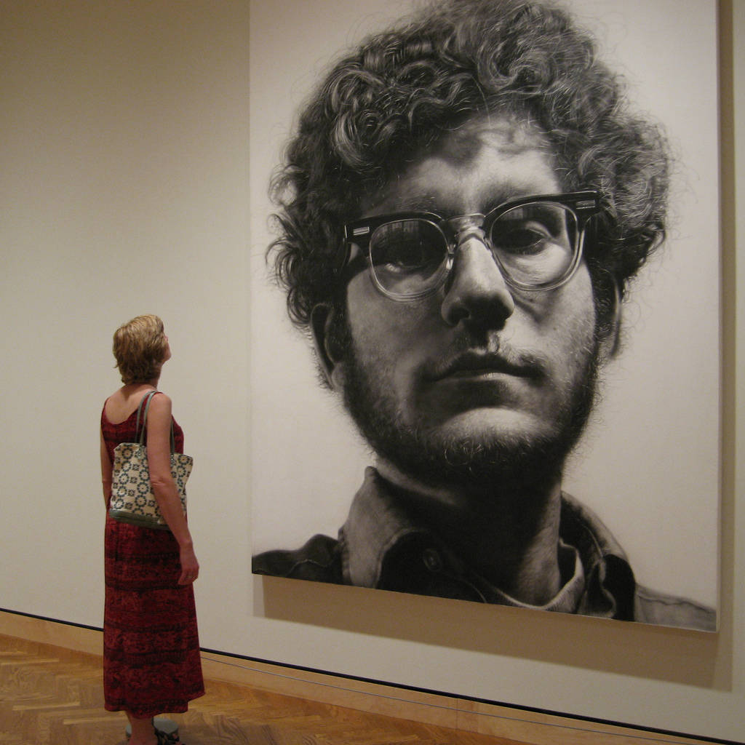
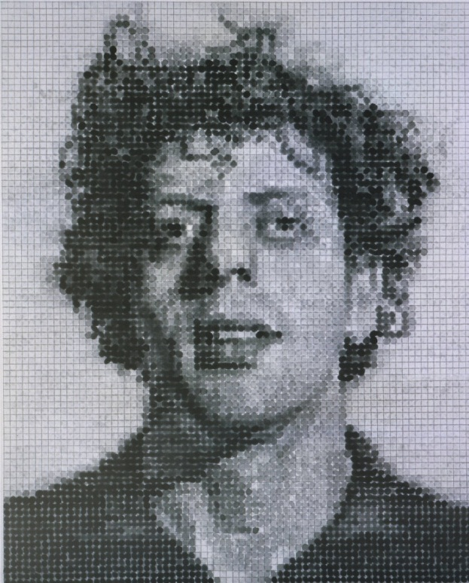
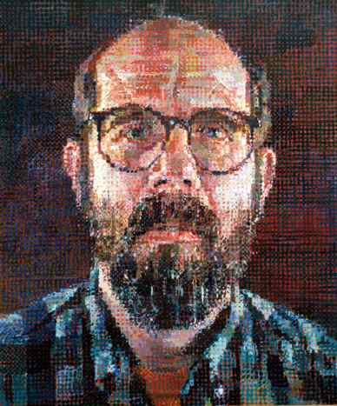
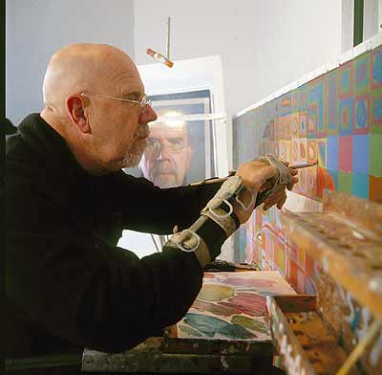
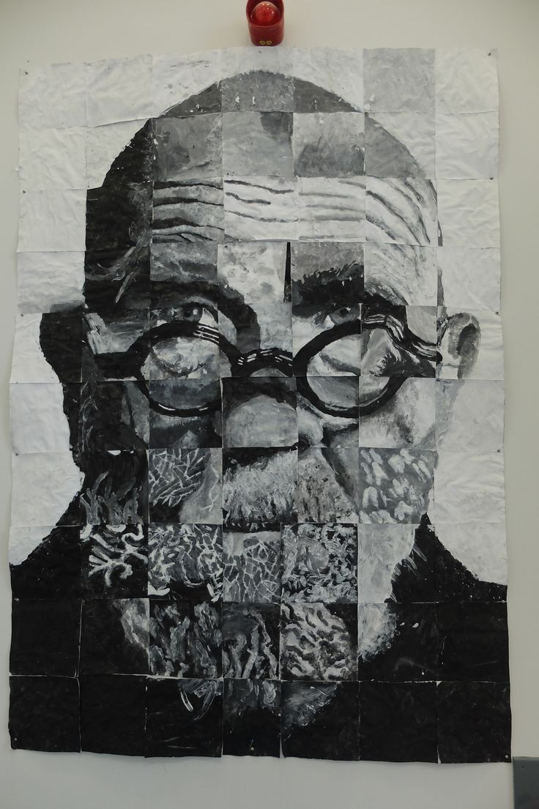
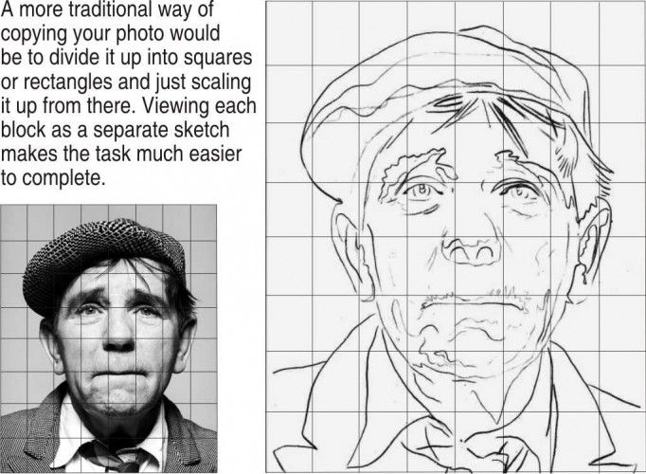
CHUCK CLOSE Grid Master

Slide 3
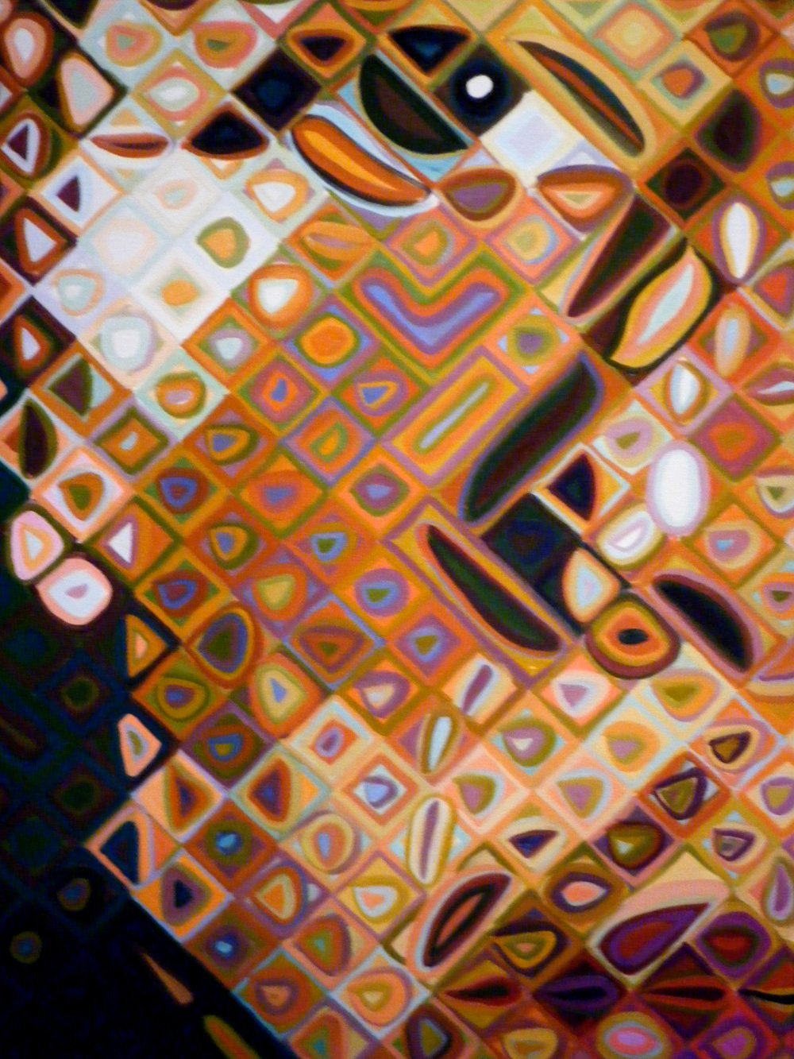
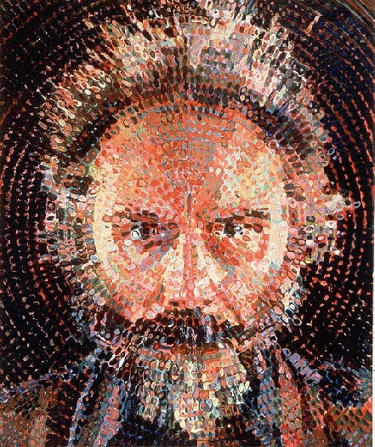
Using the Grid -differently

Slide 4
WHAT IS A GRID?
The grid method involves drawing a grid over a reference image, then drawing a grid of equal ratio or larger size on your work surface (paper, canvas, wood panel, etc). ...

Slide 5
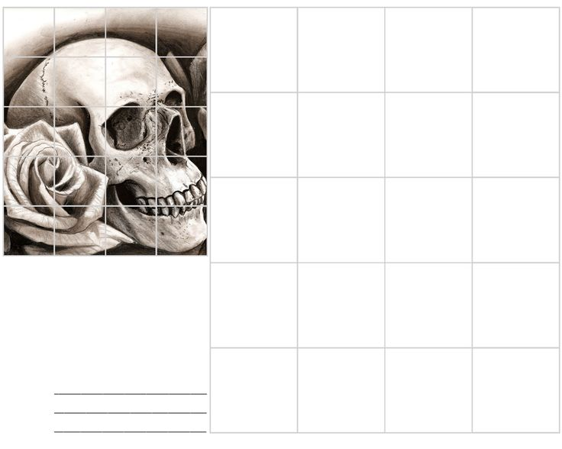
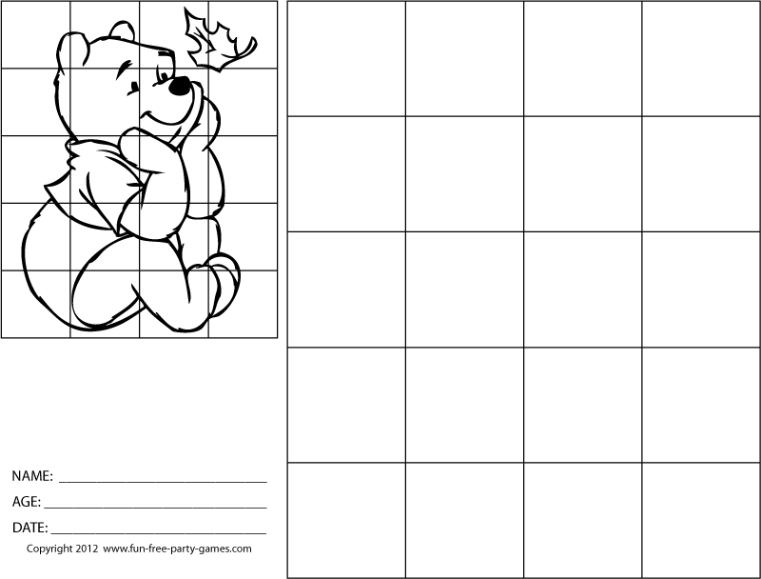
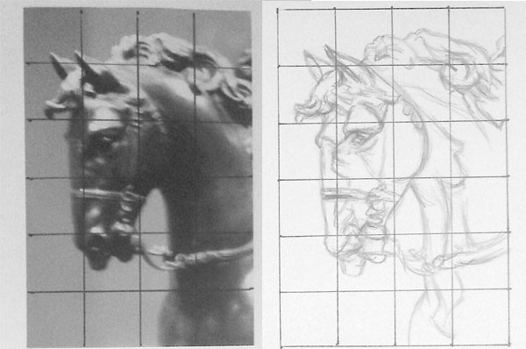
GRID TUTORIALS
https://www.youtube.com/watch?v=BcNXSF7rfSg Easy grid 2:43
https://www.youtube.com/watch?v=mZifr5RYbco Traditional grid step by step 4:55
https://www.youtube.com/watch?v=2LJF8OTG3N4 Copy and enlarge with a grid

Slide 6
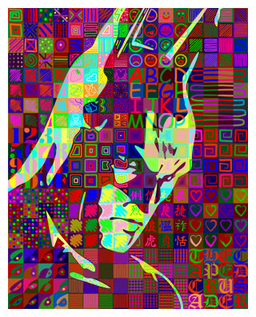
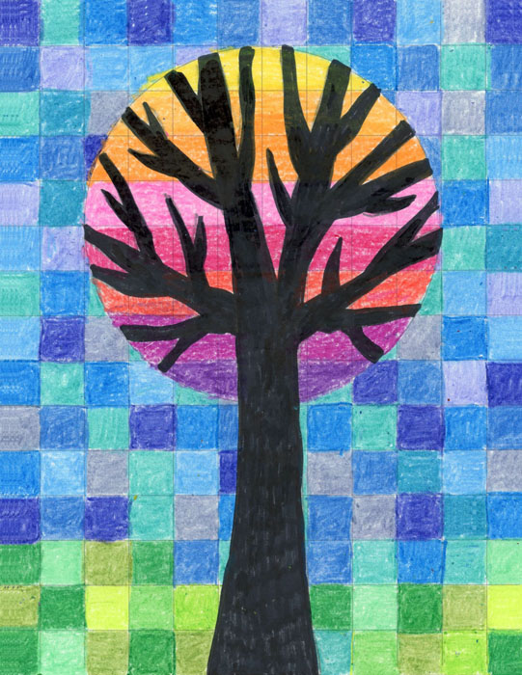
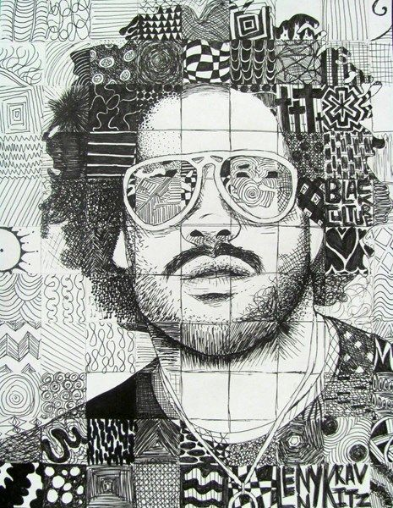
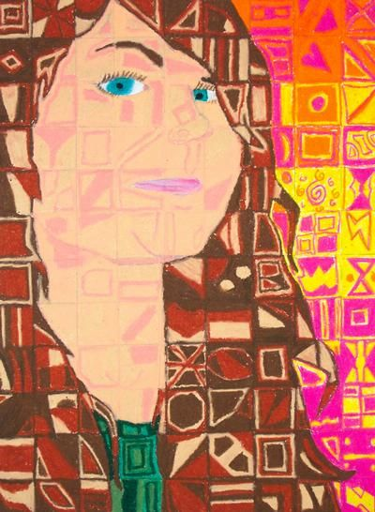
CREATIVE VARIATIONS

Slide 7
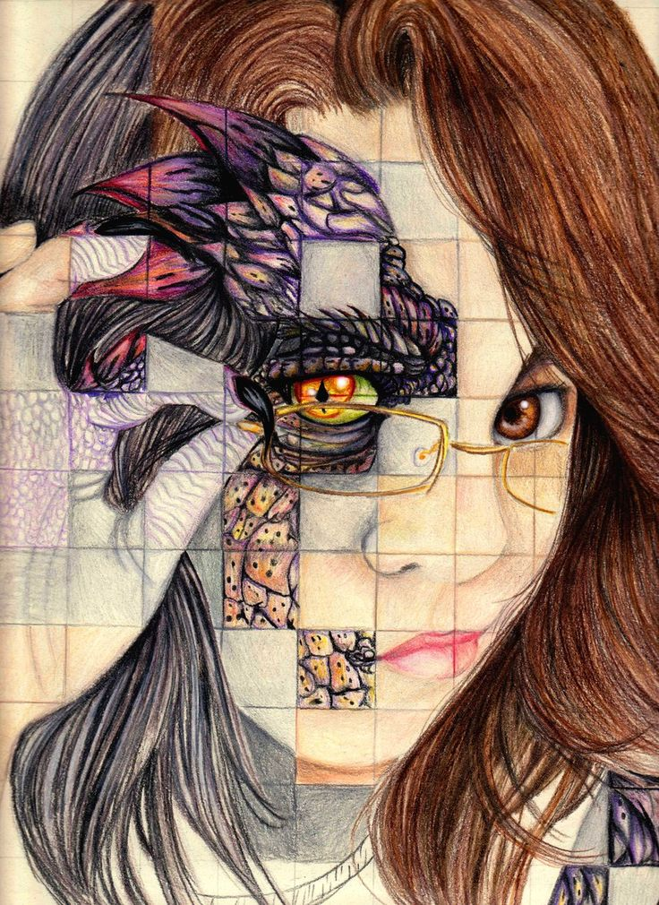
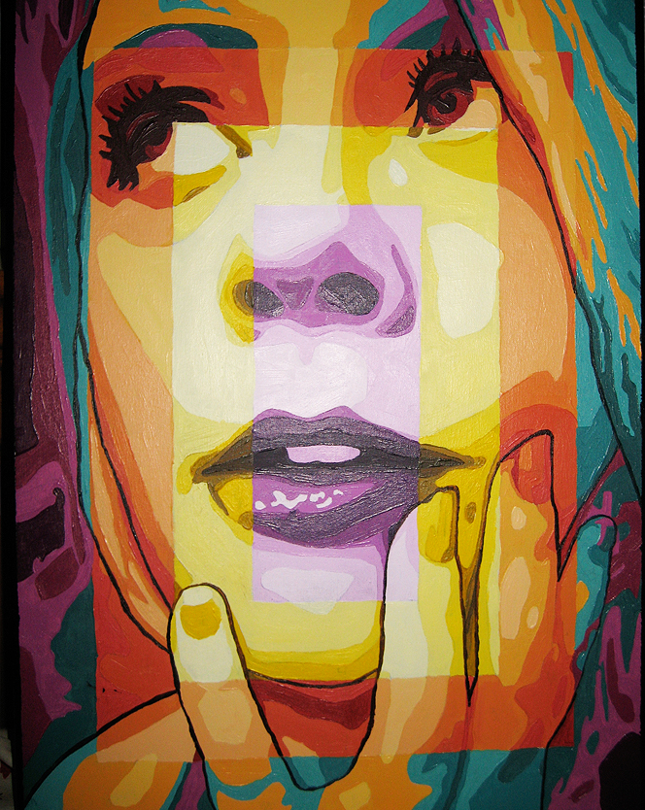
MY FAVORITE GRID DRAWING

